Slide 1

18ECE201J Python and Scientific Python 2021-2022(odd)
Dr. V.Sarada
SRMIST
ECE

Slide 2
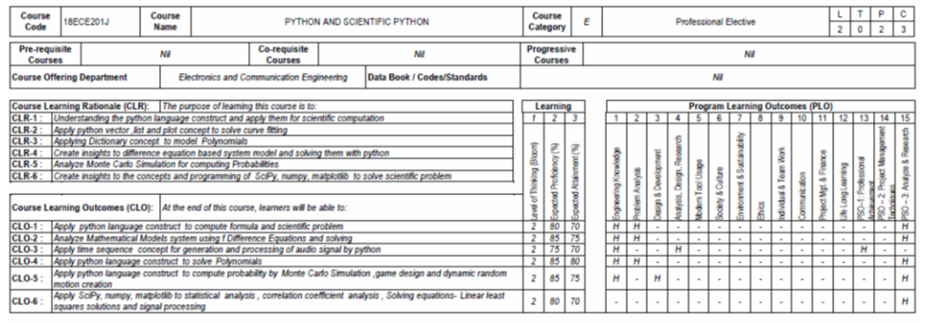
Syllabus

Slide 3
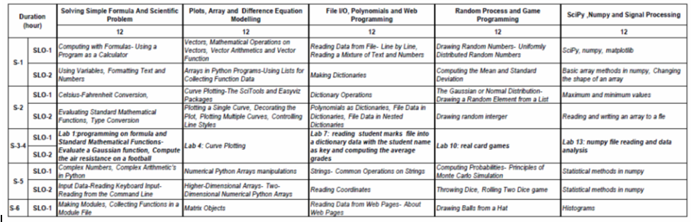
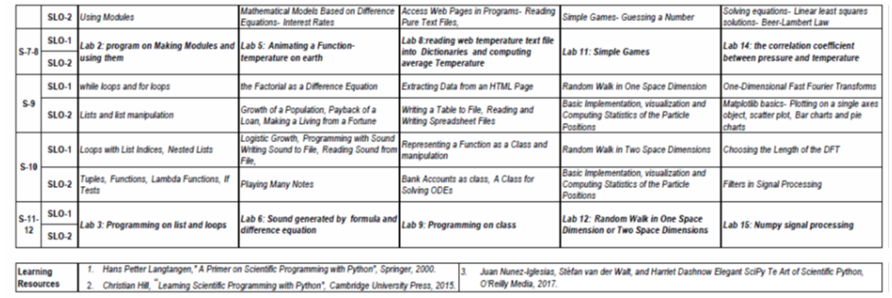

Slide 4
Unit 1
Session 1 and 2: Computing with Formulas

Slide 5
Reference Text Book
Hans Petter Langtangen, “A Primer on Scientific Programming with Python”
http://hplgit.github.com/scipro-primer.
Session | Topic index
1 | 1.1
2 | 1.3,1.4,1.5.2,1.6
3,4 (Lab 1) | Ex:1.10,1.11
5 | 4.1,4.2,4.5,4.6
6 | 4.9
7,8(Lab 2) | Ex:4.19
9 | 2.1,2.2,2.3.1
10 | 2.3.3 to 2.3.7, 2.4, 2.5, 3.1, 3.1.14, 3.2.1
11,12 (Lab 3) | Ex:2.3, 2.7

Slide 6
Required software
Python Version 2.7 and above: http://python.org
Install Anaconda Navigator and Launch Jupyter notebook
Numerical Python (NumPy): http://numpy.org
Matplotlib for plotting: http://matplotlib.org
Ipython for interactive computing: http://ipython.org
Scitools for addons to NumPy: http://code.google.com/scitools

Slide 7
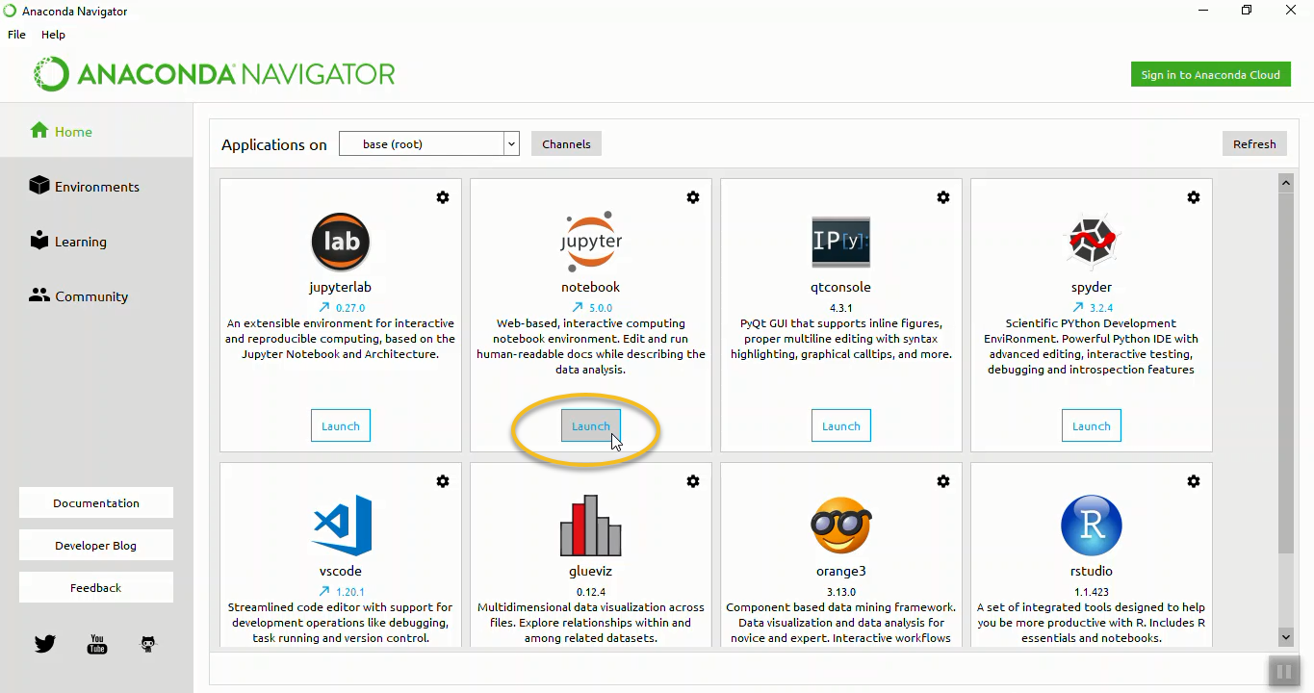
Installation
Installing Anaconda on windows
https://problemsolvingwithpython.com/01-Orientation/01.03-Installing-Anaconda-on-Windows/

Slide 8
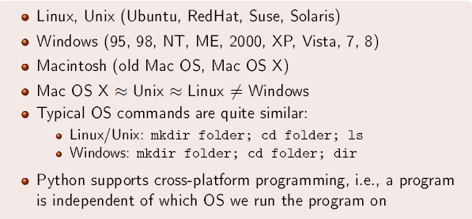
OS
An operating system (OS) is a set of programs managing hardware and software resources on a computer
Courtesy: https://hplgit.github.io/scipro-primer/slides/index.html

Slide 9
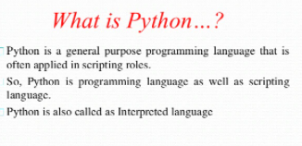
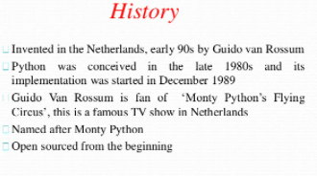

Slide 10
scripting language
a language where instructions are written for a run time environment. They do not require the compilation step and are rather interpreted
designed for integrating and communicating with other programming languages.

Slide 11
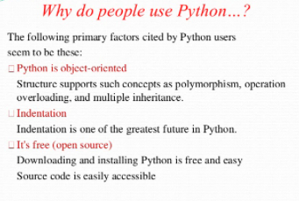
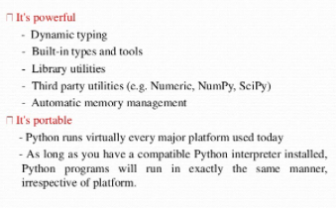

Slide 12

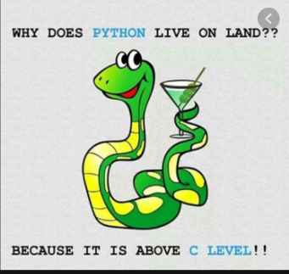

Slide 13
Unit I Learning Objectives
Students will learn how to
write and run a Python program,
work with variables,
compute with mathematical functions
Use loops, lists, tuples, functions

Slide 14
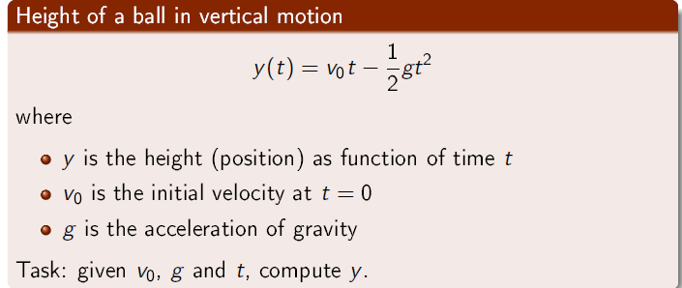
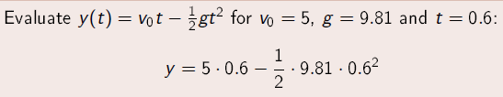
First program using python
Manual approach: problem statement
very simple one-line Python program:
print 5*0.6 - 0.5*9.81*0.6**2
What is the term program,syntax?
Courtesy: https://hplgit.github.io/scipro-primer/slides/index.html

Slide 15
Variables
to evaluate y(t) for many values of t, we must modify the t value at two places
define v0, g, t, and y as variables in the program and write the equation using variable same in mathematic expression.
v0 = 5 g = 9.81,t = 0.6,
y = v0*t - 0.5*g*t**2
print y
Introducing variables with descriptive names
initial_velocity = 5
acceleration_of_gravity = 9.81
TIME = 0.6
VerticalPositionOfBall = initial_velocity*TIME - \
0.5*acceleration_of_gravity*TIME**2
print VerticalPositionOfBall

Slide 16
How to choose variable names
They can contain both letters and numbers, cannot start with a number. It is legal to use uppercase letters, but it is a good idea to begin variable names with a lowercase letter.
The underscore character ( _ ) can appear in a name. It is often used in names with multiple words, such as my_name
reserved words (35)cannot be used as variable names
and, as, assert, break, class, continue, def, del, elif, else,except, False, finally, for, from, global, if, import, in, is, lambda,None, nonlocal, not, or, pass, raise, return, True, try, with, while,and yield.
Eg. >>> 76trombones = 'big parade‘
SyntaxError: invalid syntax
NOTE:
Program files can have a freely chosen name, but stay away from names that coincide with keywords or module names in Python.

Slide 17
Comments
Along with the program statements it is often informative to provide some comments in a natural human language to explain the idea behind the statements.
Comments in Python start with the # character
# Program for computing the height of a ball in vertical motion.
v0 = 5 # initial velocity
g = 9.81 # acceleration of gravity
t = 0.6 # time
y = v0*t - 0.5*g*t**2 # vertical position
print y

Slide 18
Arithmetic operator
+,-,*,**(exponential)
When more than one operator appears in an expression, the order of evaluation
depends on the rules of precedence. For mathematical operators.
The acronym PEMDAS is a useful way to remember
the rules:
Operators with the same precedence are evaluated from left to right. So the
expression 5-3-1 is 1, not 3, because the 5-3 happens first and then 1 is
subtracted from 2.
The modulus operator works on integers and yields the remainder when the first
operand is divided by the second. the modulus operator is a percent sign (%).
remainder = 7 % 3
>>> print(remainder) answer=1

Slide 19
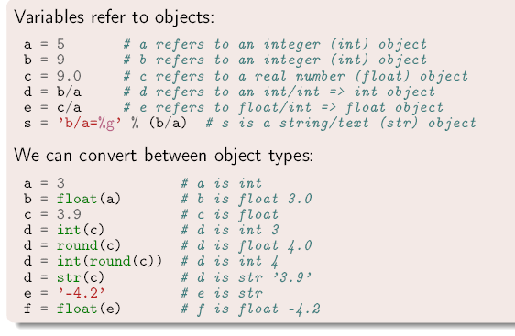
Everything in Python is an Object
Courtesy: https://hplgit.github.io/scipro-primer/slides/index.html

Slide 20
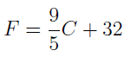
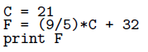
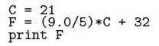
Data type conversion
example converting temperature measured in Celsius degrees to the corresponding value in Fahrenheit degrees
Program :
prints the value is 53. It is incorrect
Correct program :
output becomes 69.8, which is correct`
Note: The above error is not occur the latest version

Slide 21
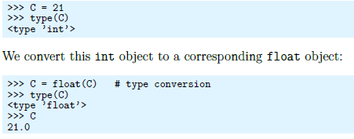
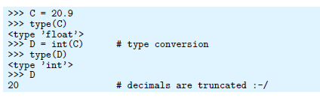
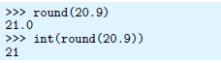
Type Conversion
type function return the object type
Courtesy: https://hplgit.github.io/scipro-primer/slides/index.html

Slide 22
Print statement
a print statement combined with some technique for formatting the numbers.
The oldest and most widely used such technique is known as print formatting
The % operator can also be used for string formatting
#print integer value
print("Total students : %3d, Boys : %2d" %(240, 120))
# print octal value
print("%7.3o" % (25))
# print exponential value
print("%10.3E" % (356.08977))

Slide 23
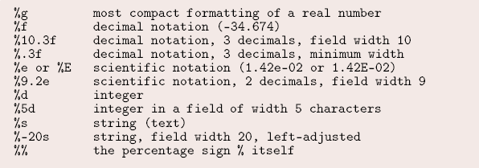
Print formats
Courtesy: https://hplgit.github.io/scipro-primer/slides/index.html

Slide 24
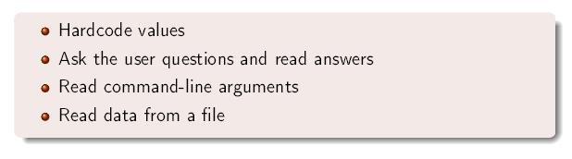
How to specify input data
Courtesy: https://hplgit.github.io/scipro-primer/slides/index.html

Slide 25
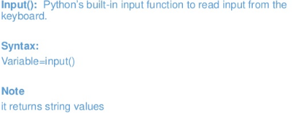
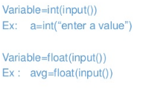
Input function

Slide 26
Handling Error
Example 1:
Print(x) >> syntax error because x is not defined
Alternate is :
try :
Print(x)
except:
Print(“data is not defined“)
Example 2:
inp = input('Enter Fahrenheit Temperature: ')
try:
fahr = float(inp)
cel = (fahr - 32.0) * 5.0 / 9.0
print(cel)
except:
print('Please enter a number')
If enter “yyu” then error is occure
There is a conditional execution structure built into Python to handle these type of expected and unexpected errors called “try / except”
The idea of try and except is that you know that some sequence of instruction(s) may have a problem and you want to add some statements to be executed if an error occurs

Slide 27
Interactive Computing
The environments where you work interactively with programming are commonly known as Python shells.
The simplest Python shell is invoked by just typing python at the command line in a terminal window.

Slide 28
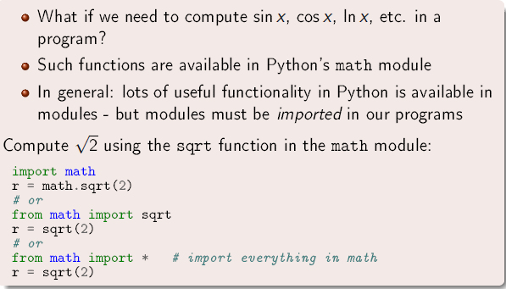
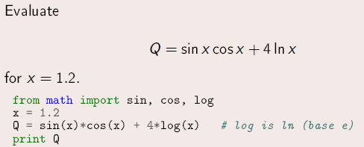
Using standard Mathematical modules
Courtesy: https://hplgit.github.io/scipro-primer/slides/index.html

Slide 29
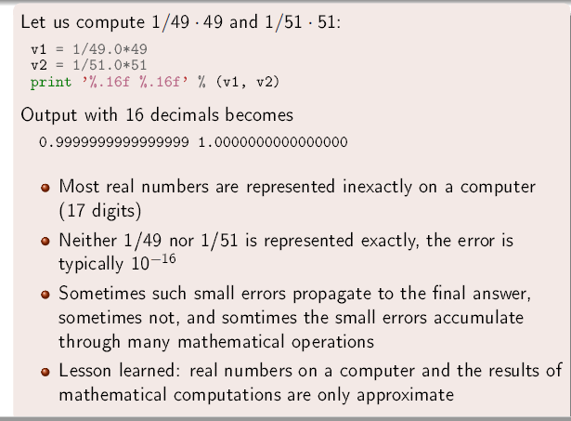
Rounding Errors
Courtesy: https://hplgit.github.io/scipro-primer/slides/index.html

Slide 30
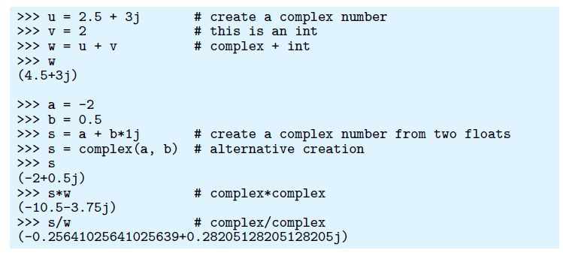
support for complex numbers
Python supports computation with complex numbers.
The imaginary unit is written as j in Python, instead of i as in mathematics.
A complex number 2 − 3i is therefore expressed as (2-3j) in Python
Courtesy: https://hplgit.github.io/scipro-primer/slides/index.html

Slide 31
Symbolic Computing
sympy is a Python library for symbolic mathematics.
Rational class represents a rational number as a pair of two Integers: the numerator and the denominator, Rational(1, 2) represents 1/2
#SYMBOLIC COMPUTATION using diff (differentiation) and integrate(Integration)
import sympy as sym
a = sym.Rational(1, 2)
print (a) >>>1/2
print(sym.diff(sym.sin(x), x)) >>> cos x
print(sym.diff(sym.sin(2 * x), x)) >>>2*cos 2*x
print(sym.diff(sym.tan(x), x)) >>> tan 2**x+1
print(sym.integrate(6 * x ** 5, x)) >>> x ** 6
print(sym.integrate(sym.sin(x), x)) >>> -cox(x)
x = sym.Symbol('x') # define variable as symbols
y = sym.Symbol('y')
print(x+x+y-y) >>>2*x

Slide 32
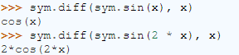
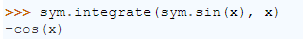
You can differentiate any SymPy expression using diff(func, var). Examples:
import sympy as sym

Slide 33
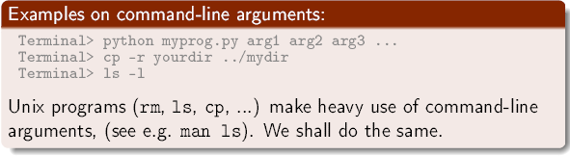
Command Line Arguments in Python
the arguments that are given after the name of the program in the command line shell of the operating system are known as Command Line Arguments. Python provides various ways of dealing with these types of arguments
Using sys.argv
It is a list of command line arguments.
len(sys.argv) provides the number of command line arguments.
sys.argv[0] is the name of the current Python script.
Courtesy: https://hplgit.github.io/scipro-primer/slides/index.html

Slide 34
Reading from Command line
Example :
import sys
C=int(sys.argv[1])
F=(9/5)*C+32
print ("the temp in Fahrenheit %f and Celsius %f" %(F,C))

Slide 35
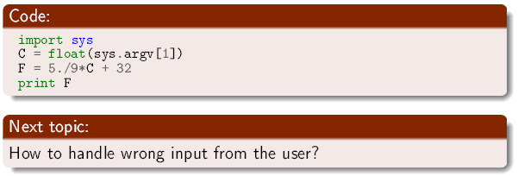
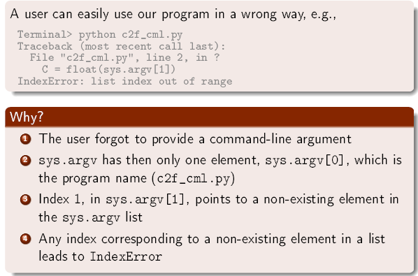
Wrong Input from User
Courtesy: https://hplgit.github.io/scipro-primer/slides/index.html

Slide 36
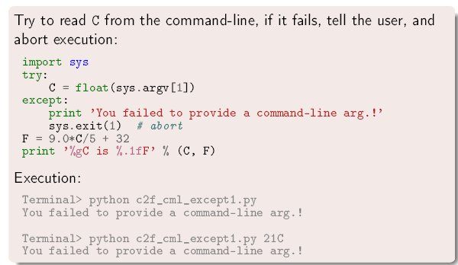
Courtesy: https://hplgit.github.io/scipro-primer/slides/index.html

Slide 37
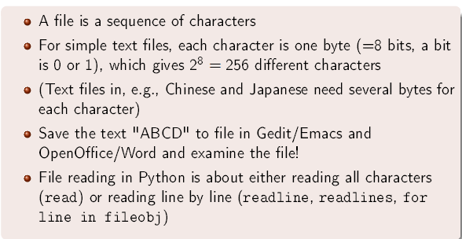
What is a file?
Courtesy: https://hplgit.github.io/scipro-primer/slides/index.html

Slide 38
Reading data from file
File : is a sequence of character ,each character is 8 bit lenth
Steps for reading a text file in Python
First, open a text file for reading by using the open() function.
Second, read text from the text file using the file read(), readline(),
or readlines() method of the file object.
read() – read all text from a file into a string. This method is useful if you have a small file and you want to manipulate the whole text of that file.
readline() – read the text file line by line and return all the lines as strings.
readlines() – read all the lines of the text file and return them as a list of strings.
Third, close the file using the file close() method.

Slide 39
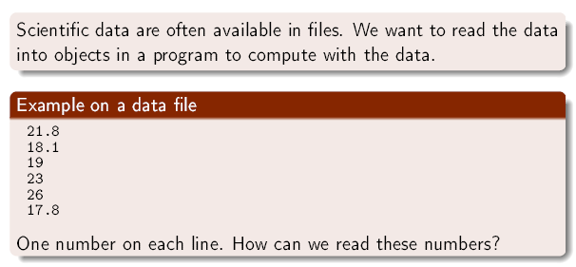
Example1 :
infile=open('data.txt','r')
for line in infile:
print(line)
Example2 :
infile=open('data.txt','r')
sum=0
for line in infile:
x=float(line)
sum+=x
print("sum is", sum)

Slide 40
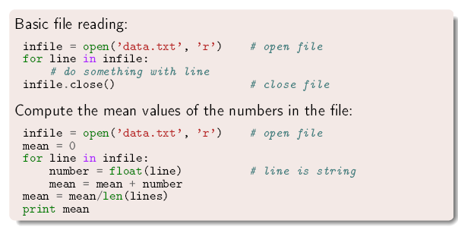
Reading data from file
Example 3:

Slide 41
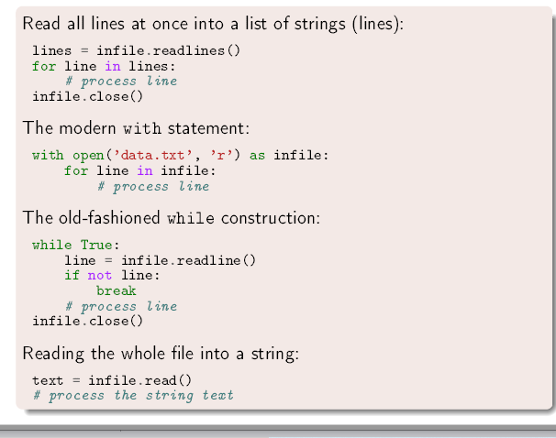
Alternative ways to read a file
Courtesy: https://hplgit.github.io/scipro-primer/slides/index.html

Slide 42
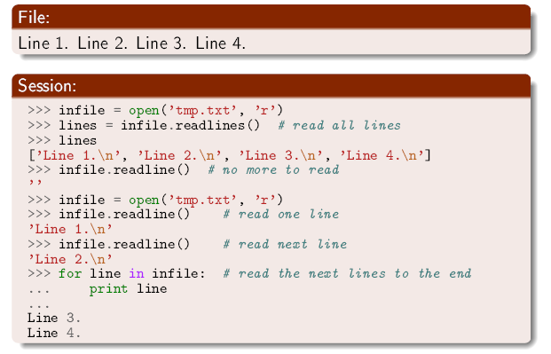
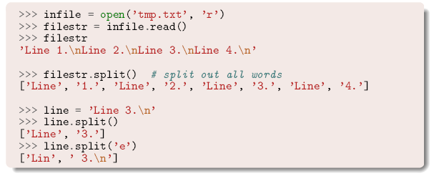
File reading Demo
Courtesy: https://hplgit.github.io/scipro-primer/slides/index.html

Slide 43
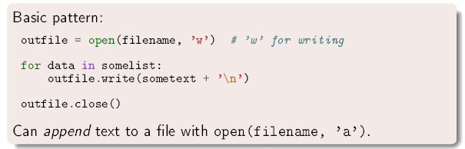
Writing Data to a file
Courtesy: https://hplgit.github.io/scipro-primer/slides/index.html

Slide 44
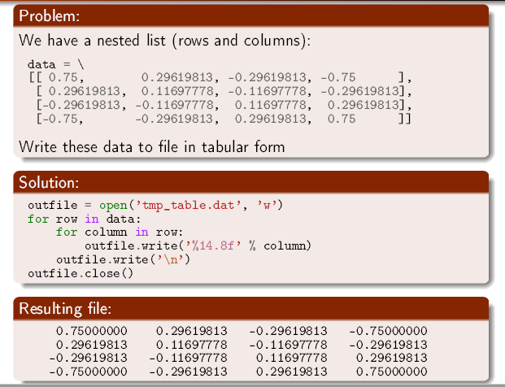
Writing a table
Example : The data in List is write into a file in table form
Courtesy: https://hplgit.github.io/scipro-primer/slides/index.html

Slide 45
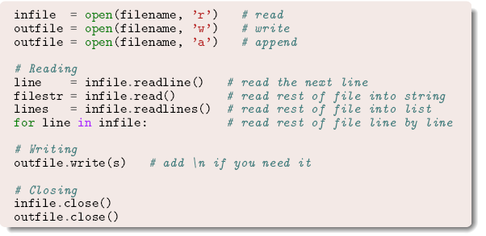
Summary Reading and Writing
Courtesy: https://hplgit.github.io/scipro-primer/slides/index.html

Slide 46
Home Work
Find out why the following programs do not work
C = A + B
A = 3
B = 2
print C
x=1
Print ‘sin(%g)=%g’ % (x, sin(x))

Slide 47
Home Work Find errors in the following statements
1a = 2
a1 = b
x = 2
y = X + 4 # is it 6?
from Math import tan
print tan(pi)
pi = "3.14159’
print tan(pi)
c = 4**3**2**3
_ = ((c-78564)/c + 32))
discount = 12%
AMOUNT = 120.-
amount = 120$
address = hpl@simula.no
and = duck
class = ’INF1100, gr 2"
continue_ = x > 0
rev = fox = True
Norwegian = [’a human language’]
true = fox is rev in Norwegian

Slide 48
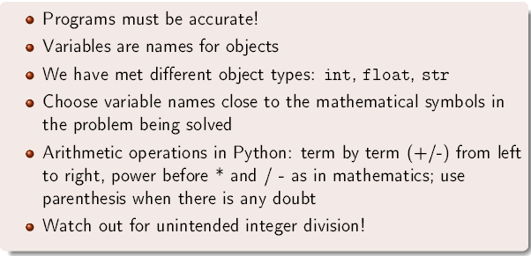
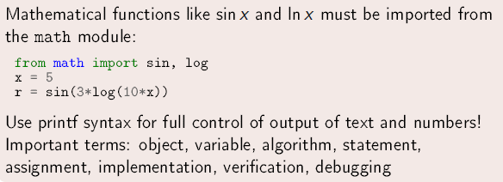
Summary
Courtesy: https://hplgit.github.io/scipro-primer/slides/index.html

Slide 49
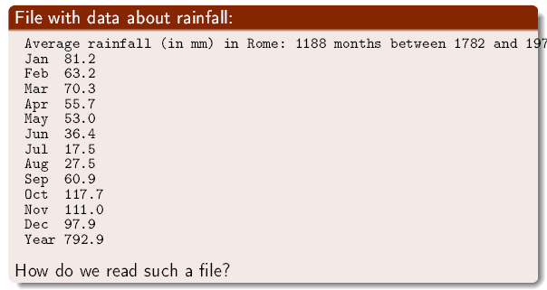
Reading a mixture of text and numbers
Courtesy: https://hplgit.github.io/scipro-primer/slides/index.html

Slide 50
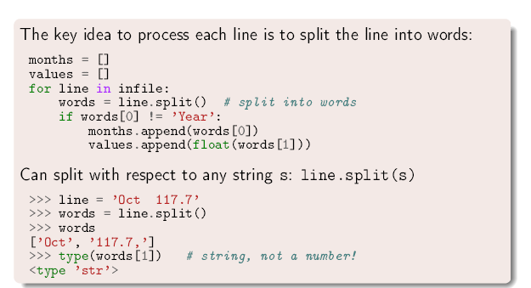
Reading a mixture of text and numbers
Courtesy: https://hplgit.github.io/scipro-primer/slides/index.html

Slide 51
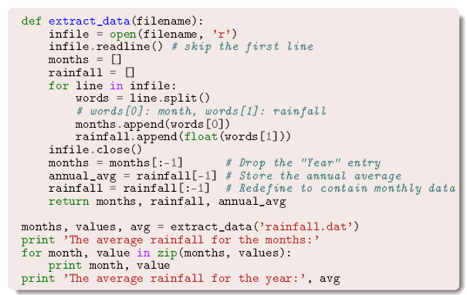
Complete Program
Courtesy: https://hplgit.github.io/scipro-primer/slides/index.html

Slide 52
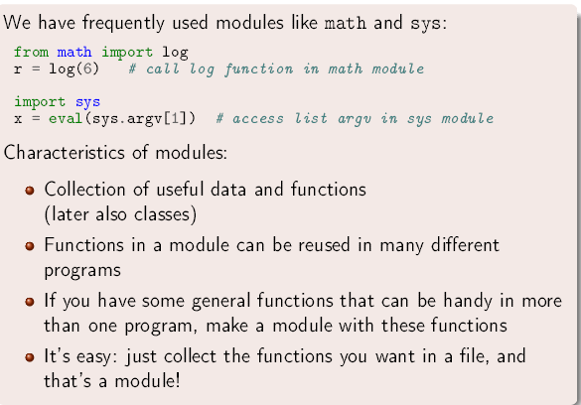
Making Own Modules
Courtesy: https://hplgit.github.io/scipro-primer/slides/index.html

Slide 53
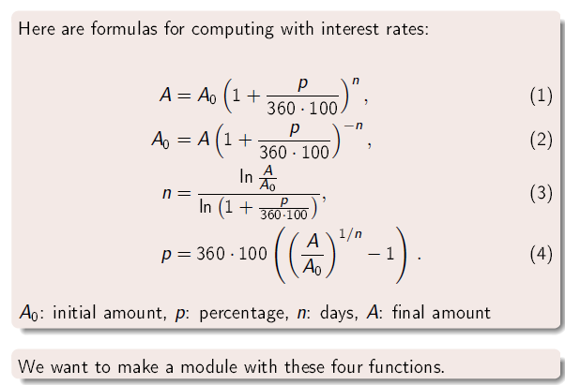
Making Own Modules
Courtesy: https://hplgit.github.io/scipro-primer/slides/index.html

Slide 54
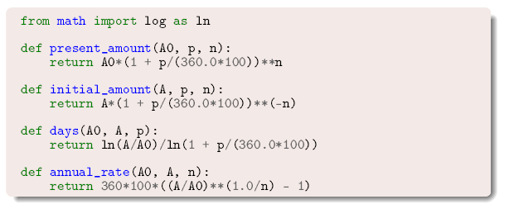

Courtesy: https://hplgit.github.io/scipro-primer/slides/index.html

Slide 55
__name__ (A Special variable) in Python
__name__ is a built-in variable which evaluates to the name of the current module. Thus it can be used to check whether the current script is being run on its own or being imported somewhere else by combining it with if statement, as shown below.
by importing, the __name__ variable is set as the name of the python script, i.e. File1. Thus, it can be said that if __name__ == “__main__” is the part of the program that runs when the script is run
File name as area.py
def calculate_area(base,hight):
print("__name__",__name__)
return 1/2*base*hight
if __name__=="__main__":
print("i am in area.py")
a=calculate_area(10,20)
print("area=",a)
import area
print("i am in caller module")
print(area.calculate_area(3,10))
Note: run the code and check the output

Slide 56

Adding test block in a module
Courtesy: https://hplgit.github.io/scipro-primer/slides/index.html

Slide 57

Test block in functions
Courtesy: https://hplgit.github.io/scipro-primer/slides/index.html

Slide 58

How Python can find new module
Courtesy: https://hplgit.github.io/scipro-primer/slides/index.html

Slide 59

Example
Courtesy: https://hplgit.github.io/scipro-primer/slides/index.html

Slide 60
Loops
Repetitive tasks in a program can be automated by loops
While and for loops available in python

Slide 61


While Loop
Courtesy: https://hplgit.github.io/scipro-primer/slides/index.html

Slide 62

for Loop
A for loop is used for iterating over a sequence (that is either a list, a tuple, a dictionary, a set, or a string).
Even strings are iterable objects, they contain a sequence of characters:
The range() Function To loop through a set of code a specified number of times,
The range() function returns a sequence of numbers, starting from 0 by default, and increments by 1 (by default), and ends at a specified number.
Example
for x in "banana":
print(x)
Courtesy: https://hplgit.github.io/scipro-primer/slides/index.html

Slide 63

Making a table with for loop
Courtesy: https://hplgit.github.io/scipro-primer/slides/index.html

Slide 64

Mathematical sum using loops
Courtesy: https://hplgit.github.io/scipro-primer/slides/index.html

Slide 65


Boolean expression – T or F

Slide 66

General form of if tests
Courtesy: https://hplgit.github.io/scipro-primer/slides/index.html

Slide 67


Example on multiple branching
In line if tests
Courtesy: https://hplgit.github.io/scipro-primer/slides/index.html

Slide 68

Lists
Lists are objects for storing a sequence of things (objects)
Courtesy: https://hplgit.github.io/scipro-primer/slides/index.html

Slide 69
List
Lists are used to store multiple values in a single variable.
Lists are one of 4 built-in data types in Python used to store collections of data, the other 3 are Tuple, Set, and Dictionary, all with different qualities and usage
List items are ordered, changeable, and allow duplicate values.
Lists are created using square brackets
Eg. list1 = ["abc", 34, True, 40, "male"]
List2=[“20,30,40]
print(type(list1))
list1 = list (("abc", 34, True, 40, "male ")) # note the double round-brackets
To determine how many item in the list by using len() function.
Len(list1)

Slide 70
Built-in functions with List
Function | Description
sum() | Sums up the numbers in the list
max() | return maximum element of given list
min() | return minimum element of given list
len() | Returns length of the list or size of the list
Syntax : function name(listname)

Slide 71
List Methods
Function | Description
Append() | Add an element to the end of the list
Extend() | Add all elements of a list to the another list
Insert() | Insert an item at the defined index
Remove() | Removes an item from the list
Pop() | Removes and returns an element at the given index
Clear() | Removes all items from the list
Index() | Returns the index of the first matched item
Count() | Returns the count of number of items passed as an argument
Sort() | Sort items in a list in ascending order
Reverse() | Reverse the order of items in the list
copy() | Returns a copy of the list
Syntax : listname.method name()

Slide 72
List Slicing operation
list1=[1,2,3,1] #create a list using []
print (list1)
print (len(list1))
print (max(list1))
print(min(list1))
print (sum(list1))
list2=list(('a','b','c')) # create a list using list() construct
print (list2)
list1.append(4) #note at a time only one element can be append
print (list1)
list1.extend(list2) #add content of one list into another list just as joining lists
print(list1)
list1.count(1) #no of time occurrence of the element
list2.remove('c') #remove only one element at a time
print (list2)
list2.pop(1) #remove element on index based
print (list2)
list4=[6,7,3]
list4.sort() #for sorting the list and updated in the same list
print(list4)
Note: run the code and check the output

Slide 73
List Slicing operation
#list slicing
thislist = ["apple", "banana", "cherry", "orange", "kiwi", "melon", "mango"]
print(thislist[0])
print(thislist[:6]) #from index 0 to index(given-1)
print(thislist[-1]) #from last index 1 (note index start from 1 not 0 in reverse)
print(thislist[2:4])
print(thislist[2:])
list1=list(('s','r','m','i','s','t','c','h','e','n','n','a','i'))
print(list1)
print(list1[:3])
print(list1[:-3])
print(list1[4:6])
print(list1[4:-6])
Note: run the code and check the output

Slide 74

Storing Table columns as Lists
Courtesy: https://hplgit.github.io/scipro-primer/slides/index.html

Slide 75

for loop with list indices
Courtesy: https://hplgit.github.io/scipro-primer/slides/index.html

Slide 76


Change elements in a list
Courtesy: https://hplgit.github.io/scipro-primer/slides/index.html

Slide 77


List Comprehension
One of the most distinctive aspects of the language is the python list and the list compression feature, which one can use within a single line of code to construct powerful functionality
Courtesy: https://hplgit.github.io/scipro-primer/slides/index.html

Slide 78

Loops: Use of zip construct
Courtesy: https://hplgit.github.io/scipro-primer/slides/index.html

Slide 79

Nested Lists
Courtesy: https://hplgit.github.io/scipro-primer/slides/index.html

Slide 80

Table of columns Vs Table of rows
Courtesy: https://hplgit.github.io/scipro-primer/slides/index.html

Slide 81


Illustration of nested lists
Illustration of table of columns
Illustration of table of rows
Courtesy: https://hplgit.github.io/scipro-primer/slides/index.html

Slide 82

Extracting sublists (slices…)
What does this code snippet do?
Courtesy: https://hplgit.github.io/scipro-primer/slides/index.html

Slide 83

Example
Courtesy: https://hplgit.github.io/scipro-primer/slides/index.html

Slide 84

Homework
Courtesy: https://hplgit.github.io/scipro-primer/slides/index.html

Slide 85

Tuples: Constant Lists
Courtesy: https://hplgit.github.io/scipro-primer/slides/index.html

Slide 86

Need for Tuples
Courtesy: https://hplgit.github.io/scipro-primer/slides/index.html

Slide 87



Functions: An important programming tool
Courtesy: https://hplgit.github.io/scipro-primer/slides/index.html

Slide 88

Functions: An important programming tool
Courtesy: https://hplgit.github.io/scipro-primer/slides/index.html

Slide 89

Functions must be called
Courtesy: https://hplgit.github.io/scipro-primer/slides/index.html

Slide 90

Functions: Example
Courtesy: https://hplgit.github.io/scipro-primer/slides/index.html

Slide 91


Functions: Example
Courtesy: https://hplgit.github.io/scipro-primer/slides/index.html

Slide 92

Local Vs Global Variables
Courtesy: https://hplgit.github.io/scipro-primer/slides/index.html

Slide 93

Home work
Courtesy: https://hplgit.github.io/scipro-primer/slides/index.html

Slide 94

Function: Python Convention
Courtesy: https://hplgit.github.io/scipro-primer/slides/index.html

Slide 95

Functions
Courtesy: https://hplgit.github.io/scipro-primer/slides/index.html

Slide 96

Functions: Example
Courtesy: https://hplgit.github.io/scipro-primer/slides/index.html

Slide 97

Lambda functions: compact inline functions
###lambda function
def cube(y):
return y*y*y
print (cube(3))
lambda_fun=lambda y:y*y*y
print (lambda_fun(3))
Note: A function without name is lambda function

Slide 98



Summary of sessions 9 and 10
Courtesy: https://hplgit.github.io/scipro-primer/slides/index.html

Slide 99

Summary of sessions 9 and 10
Courtesy: https://hplgit.github.io/scipro-primer/slides/index.html

Slide 100


Lab Experiment
Evaluation of a Gaussian function
Compute the air resistance on a football

